Slide 1


Using Git Repository
Please mute yourself. Thank you!

Slide 2
Learning Objectives
You will learn the following concepts:
What is Git
Installing Git
Creating Git Repository
Modifying Git Repository
Adding Files
Branching And Merging
Notes:
By the end of this module, you’ll be able to:
Understand data analysis
Get started with Power BI

Slide 3




What is git
Git is a DevOps tool used for source code management.
It is a free and open-source version control system.
Git is used to tracking changes in the source code or keep track of changes to any type of plaintext file project
It enables multiple developers to work together on non-linear development.
Git repository

Slide 4
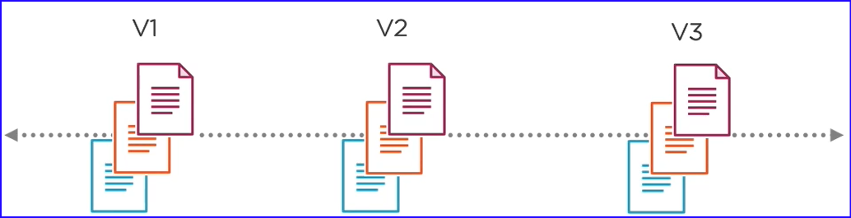
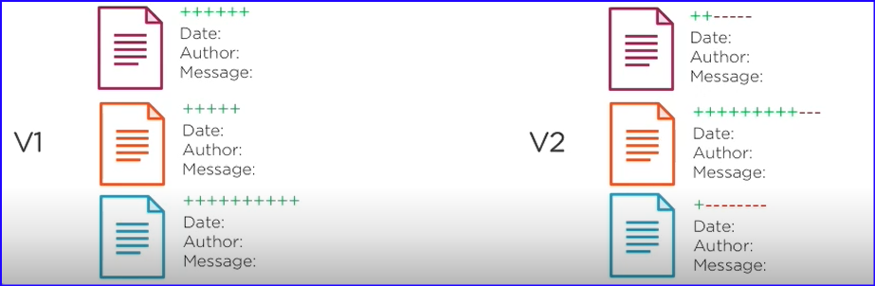
What is git
Git is a version control system (VCS).
A VCS is basically a software designed to record changes made to a file or set of files over time. This gives you the ability to revert or recall changes to one file or a set of files after you've made them.
You can compare changes made to files from one version to another, and you can see exactly what was changed in each file when the change was introduced or who introduced the change.

Slide 5
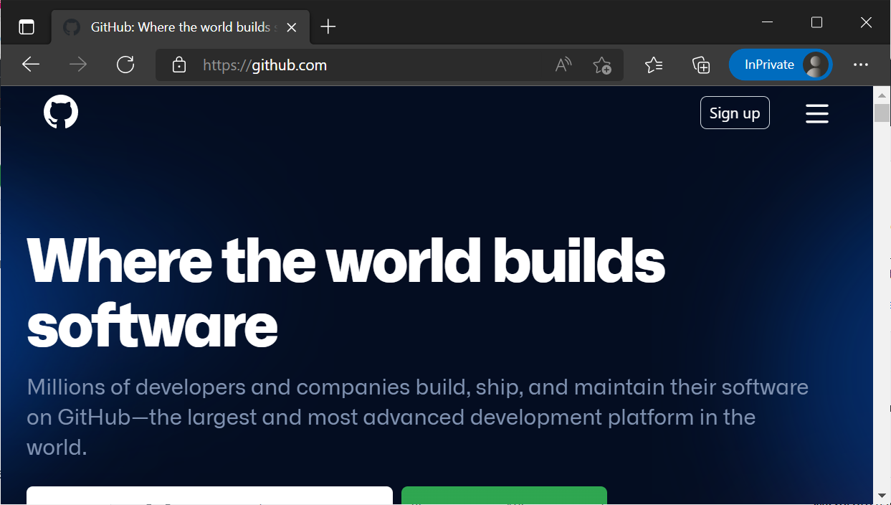
Create Github Account
Go to https://Github.com and click on Sign up

Slide 6
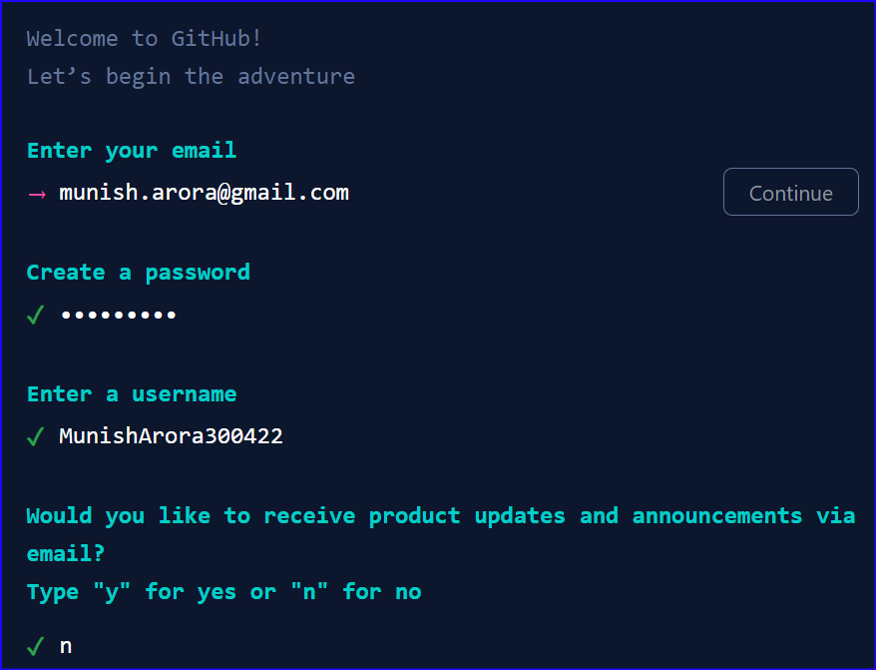
Create Github Account
And enter relevant details

Slide 7
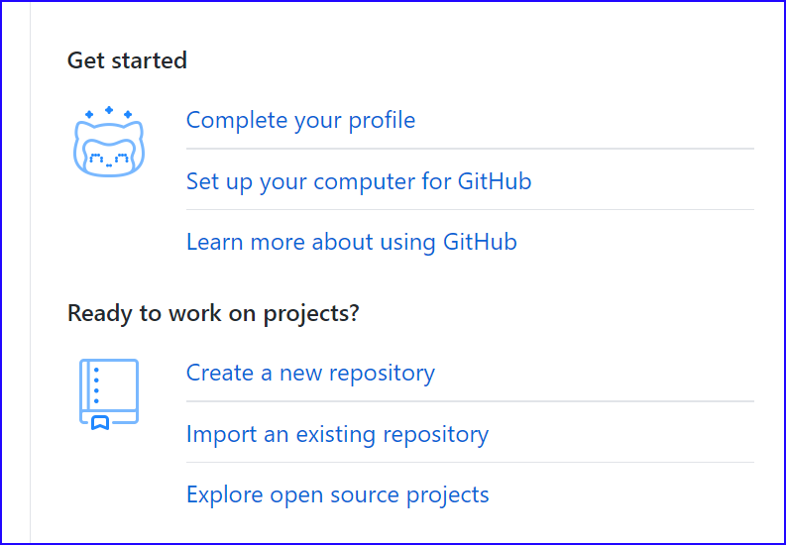
Create Github Account
After this you will receive welcome mail from github, having links for common work

Slide 8
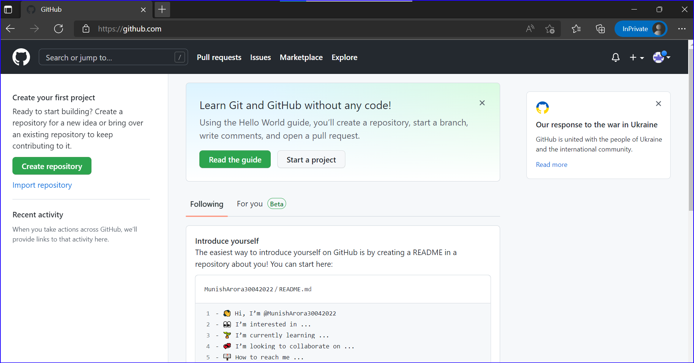
Create Github Account
It will also ask for if you want a free or paid account
Once account has been created it will show the screen as follows
Click on Create Repository to create a new repository

Slide 9
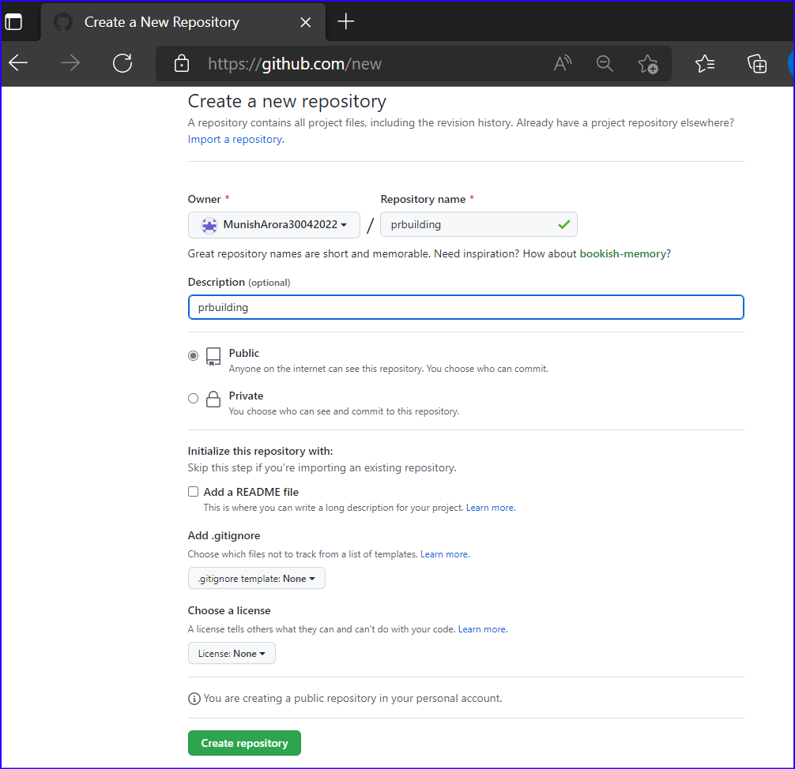
Create Github Repository
Enter the details and click on Create Repository
Give name=‘prebuilding’ to repository, and click on Create repository

Slide 10
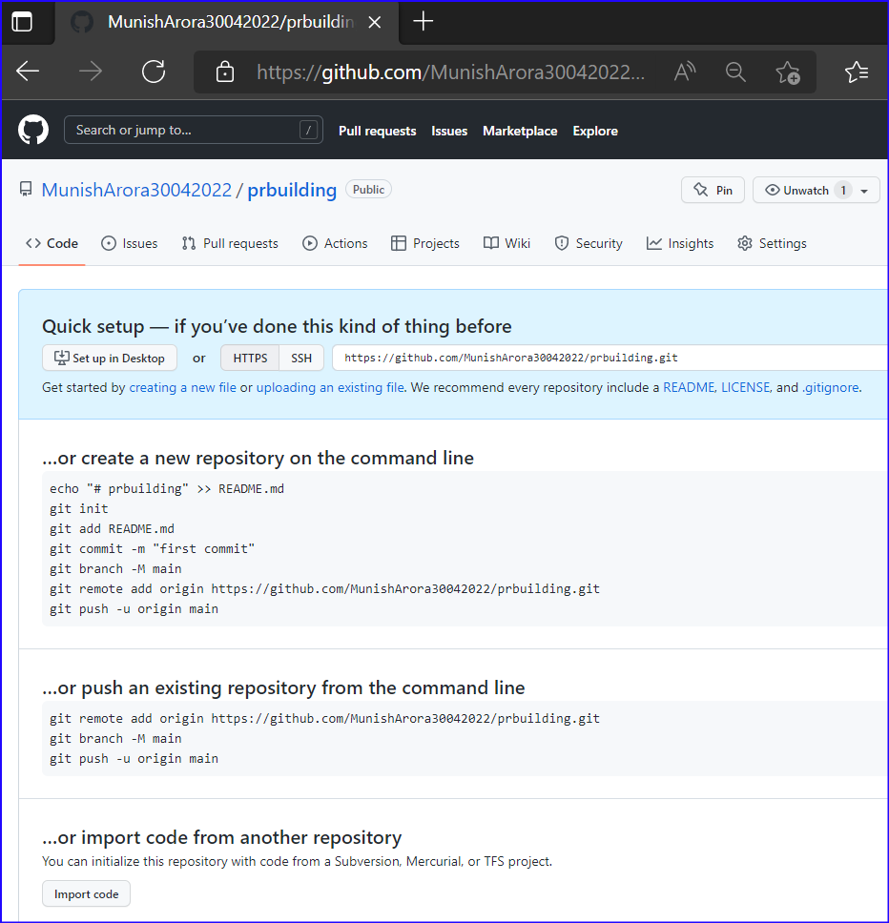
Create Github Repository
And it will show the newly created repository
In the screen it also shows the steps for creating repo using command line
Copy URL at top of page
https://github.com/MunishArora30042022/prbuilding.git

Slide 11
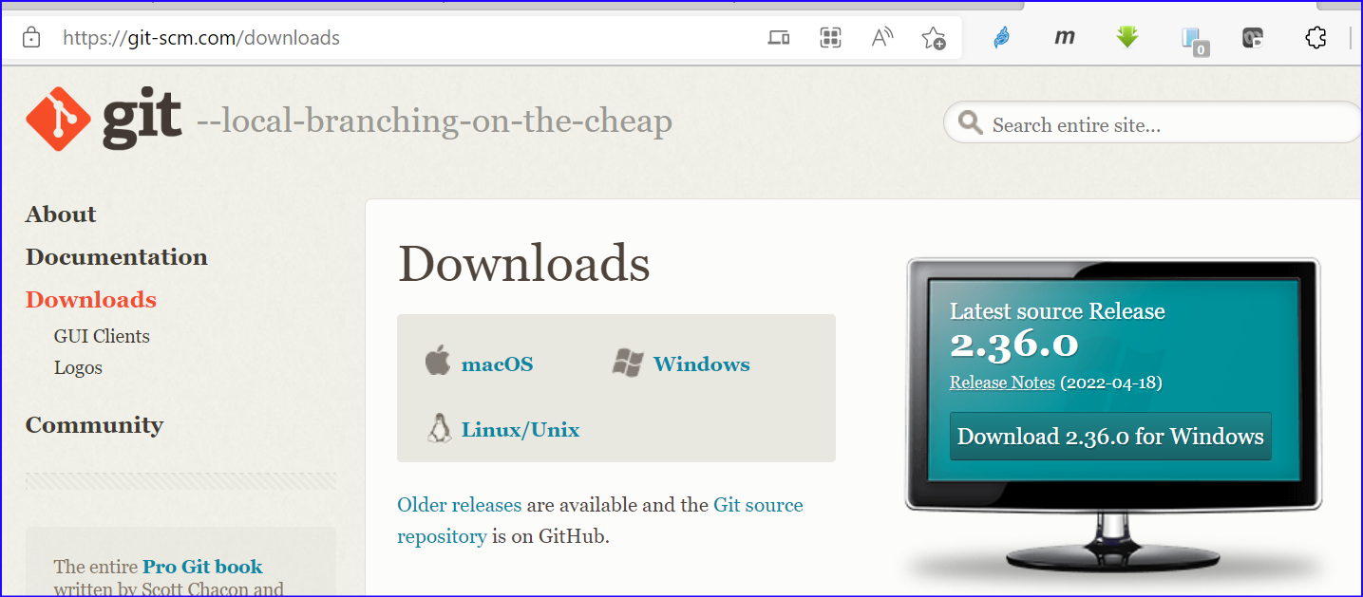
git installation
Git can be downloaded and installed from https://git-scm.com/downloads

Slide 12
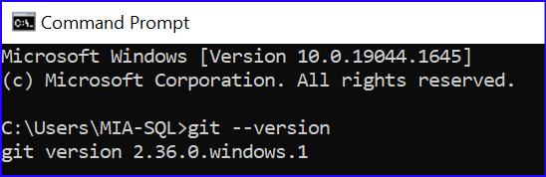
git installation
We can verify the version of git installation from command line by running the command
Git --version
and it will show the version of git.

Slide 13
git configuration
Setup and verify
Username
Email Address
E:\repo>git config --global user.name "AroraMunish"
E:\repo>git config --global user.email "Munish.arora@gmail.com"
E:\repo>git config --global user.name
AroraMunish
E:\repo>git config --global user.email
Munish.arora@gmail.com

Slide 14
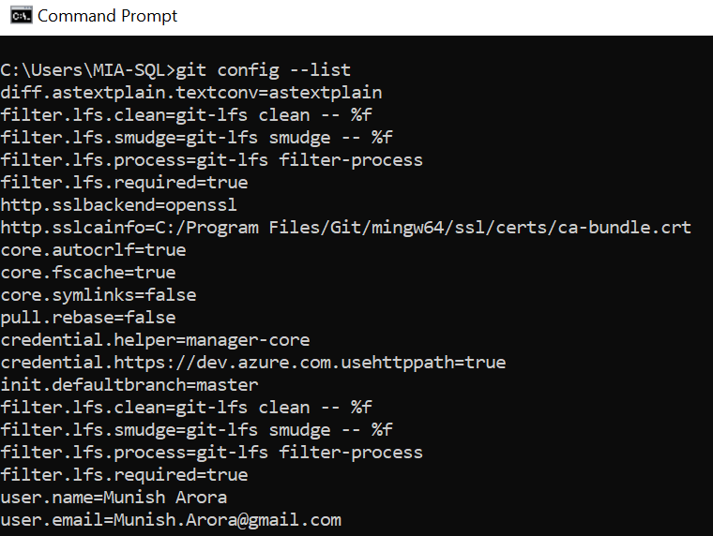
git configuration
We can further check all the settings by using
git config --list

Slide 15
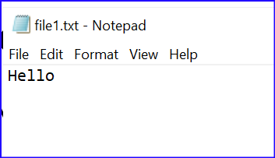
Adding and Pushing Files to Git Repository From Local Machine
You can store a variety of projects in GitHub repositories, including open source projects.
You can use repositories to collaborate with others and track your work.
C:\Users\MIA-SQL>e:
E:\>md repo
E:\>cd repo
E:\repo>md prjbuilding
E:\repo>cd prjbuilding
E:\repo\prjbuilding>git init
Initialized empty Git repository in E:/repo/prjbuilding/.git/
E:\repo\prjbuilding>notepad file1.txt
E:\repo\prjbuilding>dir
Volume in drive E is Trainings
Volume Serial Number is 746B-0F7B
Directory of E:\repo\prjbuilding
30-04-2022 17:45 <DIR> .
30-04-2022 17:45 <DIR> ..
30-04-2022 17:45 5 file1.txt
1 File(s) 5 bytes
2 Dir(s) 83,782,635,520 bytes free

Slide 16
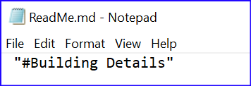
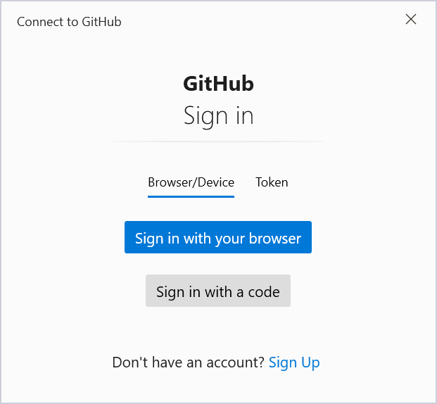
Adding and Pushing Files to Git Repository From Local Machine
Steps:
Create repo
Add Files
Push to repo
E:\repo\prjbuilding>notepad ReadMe.md
E:\repo\prjbuilding>git add .
E:\repo\prjbuilding>git commit -m "first commit"
[master (root-commit) 1a2beab] first commit
2 files changed, 2 insertions(+)
create mode 100644 ReadMe.md
create mode 100644 file1.txt
E:\repo\prjbuilding>git remote add origin https://github.com/AroraMunish/prjbuilding.git
git branch -M main
E:\repo\prjbuilding>git push -u origin main
info: please complete authentication in your browser...
Enumerating objects: 4, done.
Counting objects: 100% (4/4), done.
Delta compression using up to 8 threads
Compressing objects: 100% (2/2), done.
Writing objects: 100% (4/4), 283 bytes | 283.00 KiB/s, done.
Total 4 (delta 0), reused 0 (delta 0), pack-reused 0
To https://github.com/AroraMunish/prjbuilding.git
* [new branch] main -> main
branch 'master' set up to track 'origin/main'.

Slide 17
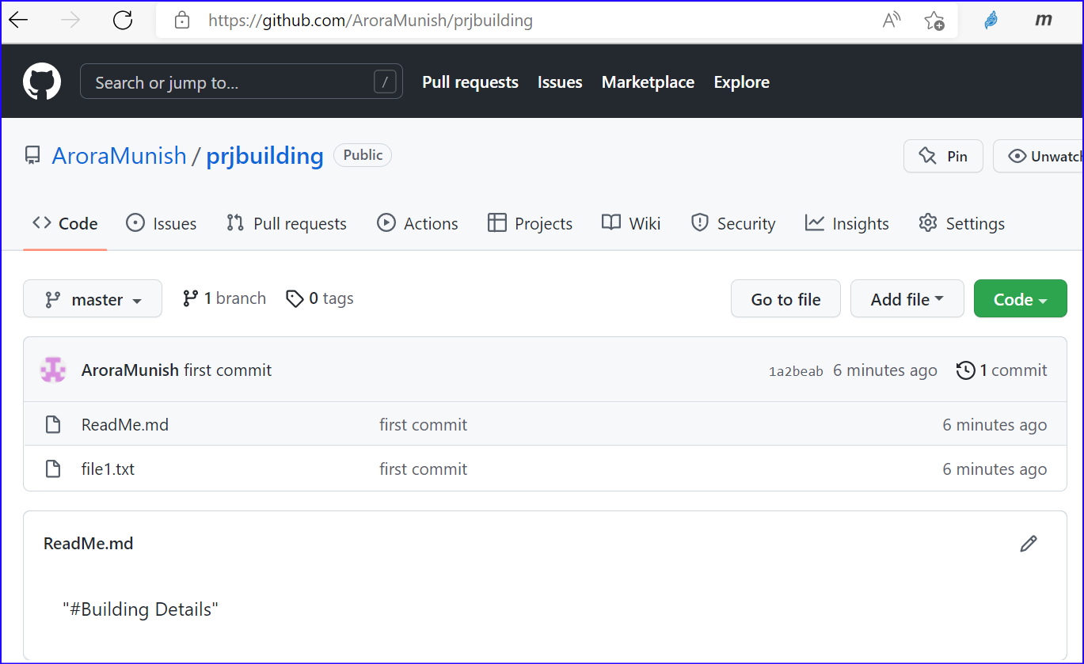
Adding and Pushing Files to Git Repository From Local Machine
The files can then be seen in repo

Slide 18
Lab 1
Lab 01: Creating And Using Git
1 Git
1.1 Installation
2 Using github
2.1 Creating Account
2.2 Creating Repository
2.3 Add the files To Repository
2.3.1 Configuring Username and password
2.3.2 Creating Local Repo, Adding Files and Pushing files to github
2.3.3 Verify Files in Repo

Slide 19
Lab
Lab 02: Git Repository-Branching And Merging
1 Branching
1.1 Creating Repository
1.2 Creating Branch
1.3 Viewing Differences
1.4 Merging to main branch

Slide 20
Module Overview
We covered the following concepts:
Data Analysis
How to get started with Power BI
Notes:
In this module we discussed:
Data Analysis
How to get started with Power BI

